Slide 1
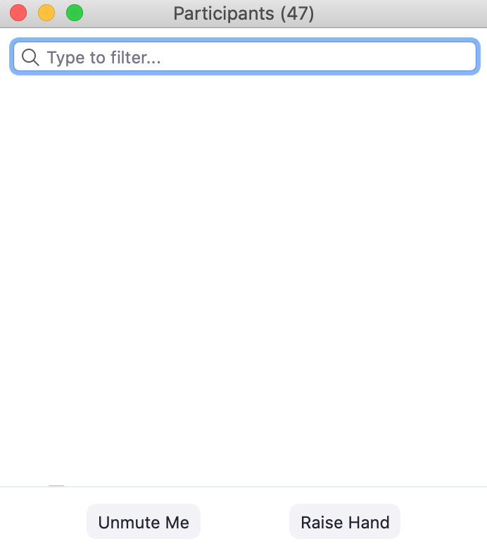
Zoom Tips for Virtual Meetings
Raise Hand to Speak
Raise Hand to Speak
1
Tap Screen
1
Respect Time Limit
3-5 minutes
2
2
Dial In Controls
*6 mute/unmute
*9 raise hand
Mute Audio / Video
Mute Audio / Video

Slide 2
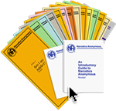
NA Literature
Available Online:
All pamphlets
Booklets
Readings
Audio version of Basic Text
https://na.org/?ID=literature

Slide 3
7th Tradition
“Every NA group ought to be fully self-supporting, declining outside contributions.”
NAWS link https://www.na.org/?ID=contribute-now

Slide 4
Who is an Addict?
Most of us do not have to think twice about this question. We know! Our whole life and thinking was centered in drugs in one form or another—the getting and using and finding ways and means to get more. We lived to use and used to live.
Very simply, an addict is a man or woman whose life is controlled by drugs. We are people in the grip of a continuing and progressive illness whose ends are always the same: jails, institutions, and death.
© 1986 by Narcotics Anonymous World Services, Inc.

Slide 5
Why Are We Here?
Before coming to the Fellowship of NA, we could not manage our own lives. We could not live and enjoy life as other people do. We had to have something different and we thought we had found it in drugs. We placed their use ahead of the welfare of our families, our wives, husbands, and our children. We had to have drugs at all costs. We did many people great harm, but most of all we harmed ourselves. Through our inability to accept personal responsibilities we were actually creating our own problems. We seemed to be incapable of facing life on its own terms.
Page 1 of 2
© 1986 by Narcotics Anonymous World Services, Inc.

Slide 6
Most of us realized that in our addiction we were slowly committing suicide, but addiction is such a cunning enemy of life that we had lost the power to do anything about it. Many of us ended up in jail, or sought help through medicine, religion, and psychiatry. None of these methods was sufficient for us. Our disease always resurfaced or continued to progress until, in desperation, we sought help from each other in Narcotics Anonymous.
After coming to NA we realized we were sick people. We suffered from a disease from which there is no known cure. It can, however, be arrested at some point, and recovery is then possible.
Page 2 of 2
© 1986 by Narcotics Anonymous World Services, Inc.

Slide 7
What is the Narcotics Anonymous Program?
NA is a nonprofit fellowship or society of men and women for whom drugs had become a major problem. We are recovering addicts who meet regularly to help each other stay clean. This is a program of complete abstinence from all drugs. There is only one requirement for membership, the desire to stop using. We suggest that you keep an open mind and give yourself a break. Our program is a set of principles written so simply that we can follow them in our daily lives. The most important thing about them is that they work.
Page 1 of 2
© 1986 by Narcotics Anonymous World Services, Inc.

Slide 8
There are no strings attached to NA. We are not affiliated with any other organizations. We have no initiation fees or dues, no pledges to sign, no promises to make to anyone. We are not connected with any political, religious, or law enforcement groups, and are under no surveillance at any time. Anyone may join us regardless of age, race, sexual identity, creed, religion, or lack of religion.
We are not interested in what or how much you used or who your connections were, what you have done in the past, how much or how little you have, but only in what you want to do about your problem and how we can help. The newcomer is the most important person at any meeting, because we can only keep what we have by giving it away. We have learned from our group experience that those who keep coming to our meetings regularly stay clean.
Page 2 of 2
© 1986 by Narcotics Anonymous World Services, Inc.

Slide 9
How it Works
If you want what we have to offer, and are willing to make the effort to get it, then you are ready to take certain steps. These are the principles that made our recovery possible.
1. We admitted that we were powerless over our addiction, that our lives had become unmanageable.
2. We came to believe that a Power greater than ourselves could restore us to sanity.
3. We made a decision to turn our will and our lives over to the care of God as we understood Him.
4. We made a searching and fearless moral inventory of ourselves.
Page 1 of 5
© 1986 by Narcotics Anonymous World Services, Inc.

Slide 10
How it Works
5. We admitted to God, to ourselves, and to another human being the exact nature of our wrongs.
6. We were entirely ready to have God remove all these defects of character.
7. We humbly asked Him to remove our shortcomings.
8. We made a list of all persons we had harmed, and became willing to make amends to them all.
9. We made direct amends to such people wherever possible, except when to do so would injure them or others.
Page 2 of 5
© 1986 by Narcotics Anonymous World Services, Inc.

Slide 11
How it Works
10. We continued to take personal inventory and when we were wrong promptly admitted it.
11. We sought through prayer and meditation to improve our conscious contact with God as we understood Him, praying only for knowledge of His will for us and the power to carry that out.
12. Having had a spiritual awakening as a result of these steps, we tried to carry this message to addicts, and to practice these principles in all our affairs.
This sounds like a big order, and we can’t do it all at once. We
didn’t become addicted in one day, so remember—easy does it.
Page 3 of 5
© 1986 by Narcotics Anonymous World Services, Inc.

Slide 12
How it Works
There is one thing more than anything else that will defeat us in our recovery; this is an attitude of indifference or intolerance toward spiritual principles. Three of these that are indispensable are honesty, open-mindedness and willingness. With these we are well on our way.
We feel that our approach to the disease of addiction is completely realistic for the therapeutic value of one addict helping another is without parallel. We feel that our way is practical, for one addict can best understand and help another addict. We believe that the sooner we face our problems within our society, in everyday living, just that much faster do we become acceptable, responsible, and productive members of that society.
Page 4 of 5
© 1986 by Narcotics Anonymous World Services, Inc.

Slide 13
How it Works
The only way to keep from returning to active addiction is not to take that first drug. If you are like us you know that one is too many and a thousand never enough. We put great emphasis on this, for we know that when we use drugs in any form, or substitute one for another, we release our addiction all over again.
Thinking of alcohol as different from other drugs has caused a great many addicts to relapse. Before we came to NA many of us viewed alcohol separately, but we cannot afford to be confused about this. Alcohol is a drug. We are people with the disease of addiction who must abstain from all drugs in order to recover.
Page 5 of 5
© 1986 by Narcotics Anonymous World Services, Inc.

Slide 14
The Twelve Traditions of NA
We keep what we have only with vigilance, and just as freedom for the individual comes from the Twelve Steps, so freedom for the group springs from our Traditions. As long as the ties that bind us together are stronger than those that would tear us apart, all will be well.
1. Our common welfare should come first; personal recovery depends on NA unity.
2. For our group purpose there is but one ultimate authority— a loving God as He may express Himself in our group conscience. Our leaders are but trusted servants; they do not govern.
3. The only requirement for membership is a desire to stop using.
Page 1 of 6
© 1988 by Narcotics Anonymous World Services, Inc.

Slide 15
The Twelve Traditions of NA
4. Each group should be autonomous except in matters affecting other groups or NA as a whole.
5. Each group has but one primary purpose—to carry the message to the addict who still suffers.
6. An NA group ought never endorse, finance, or lend the NA name to any related facility or outside enterprise, lest problems of money, property, or prestige divert us from our primary purpose.
7. Every NA group ought to be fully self-supporting, declining outside contributions.
8. Narcotics Anonymous should remain forever nonprofessional, but our service centers may employ special workers.
Page 2 of 6
© 1988 by Narcotics Anonymous World Services, Inc.

Slide 16
The Twelve Traditions of NA
9. NA, as such, ought never be organized, but we may create service boards or committees directly responsible to those they serve.
10. Narcotics Anonymous has no opinion on outside issues; hence the NA name ought never be drawn into public controversy.
11. Our public relations policy is based on attraction rather than promotion; we need always maintain personal anonymity at the level of press, radio, and films.
12. Anonymity is the spiritual foundation of all our Traditions, ever reminding us to place principles before personalities.
Page 3 of 6
© 1988 by Narcotics Anonymous World Services, Inc.

Slide 17
The Twelve Traditions of NA
Understanding these Traditions comes slowly over a period of time. We pick up information as we talk to members and visit various groups. It usually isn’t until we get involved with service that someone points out that “personal recovery depends on NA unity,” and that unity depends on how well we follow our Traditions. The Twelve Traditions of NA are not negotiable. They are the guidelines that keep our Fellowship alive and free.
Page 4 of 6
© 1988 by Narcotics Anonymous World Services, Inc.

Slide 18
The Twelve Traditions of NA
By following these guidelines in our dealings with others, and society at large, we avoid many problems. That is not to say that our Traditions eliminate all problems. We still have to face difficulties as they arise: communication problems, differences of opinion, internal controversies, and troubles with individuals and groups outside the Fellowship. However, when we apply these principles, we avoid some of the pitfalls.
Page 5 of 6
© 1988 by Narcotics Anonymous World Services, Inc.

Slide 19
The Twelve Traditions of NA
Many of our problems are like those that our predecessors had to face. Their hard won experience gave birth to the Traditions, and our own experience has shown that these principles are just as valid today as they were when these Traditions were formulated. Our Traditions protect us from the internal and external forces that could destroy us. They are truly the ties that bind us together. It is only through understanding and application that they work.
Page 6 of 6
© 1988 by Narcotics Anonymous World Services, Inc.

Slide 20
We Do Recover
When at the end of the road we find that we can no longer function as a human being, either with or without drugs, we all face the same dilemma. What is there left to do? There seems to be this alternative: either go on as best we can to the bitter ends—jails, institutions or death—or find a new way to live. In years gone by, very few addicts ever had this last choice. Those who are addicted today are more fortunate. For the first time in man’s entire history, a simple way has been proving itself in the lives of many addicts. It is available to us all. This is a simple spiritual—not religious—program, known as Narcotics Anonymous.
© 1986 by Narcotics Anonymous World Services, Inc.

Slide 21
Just for Today Meditation
Who wants to read…
Just for Today here: https://jftna.org/jft/

Slide 22
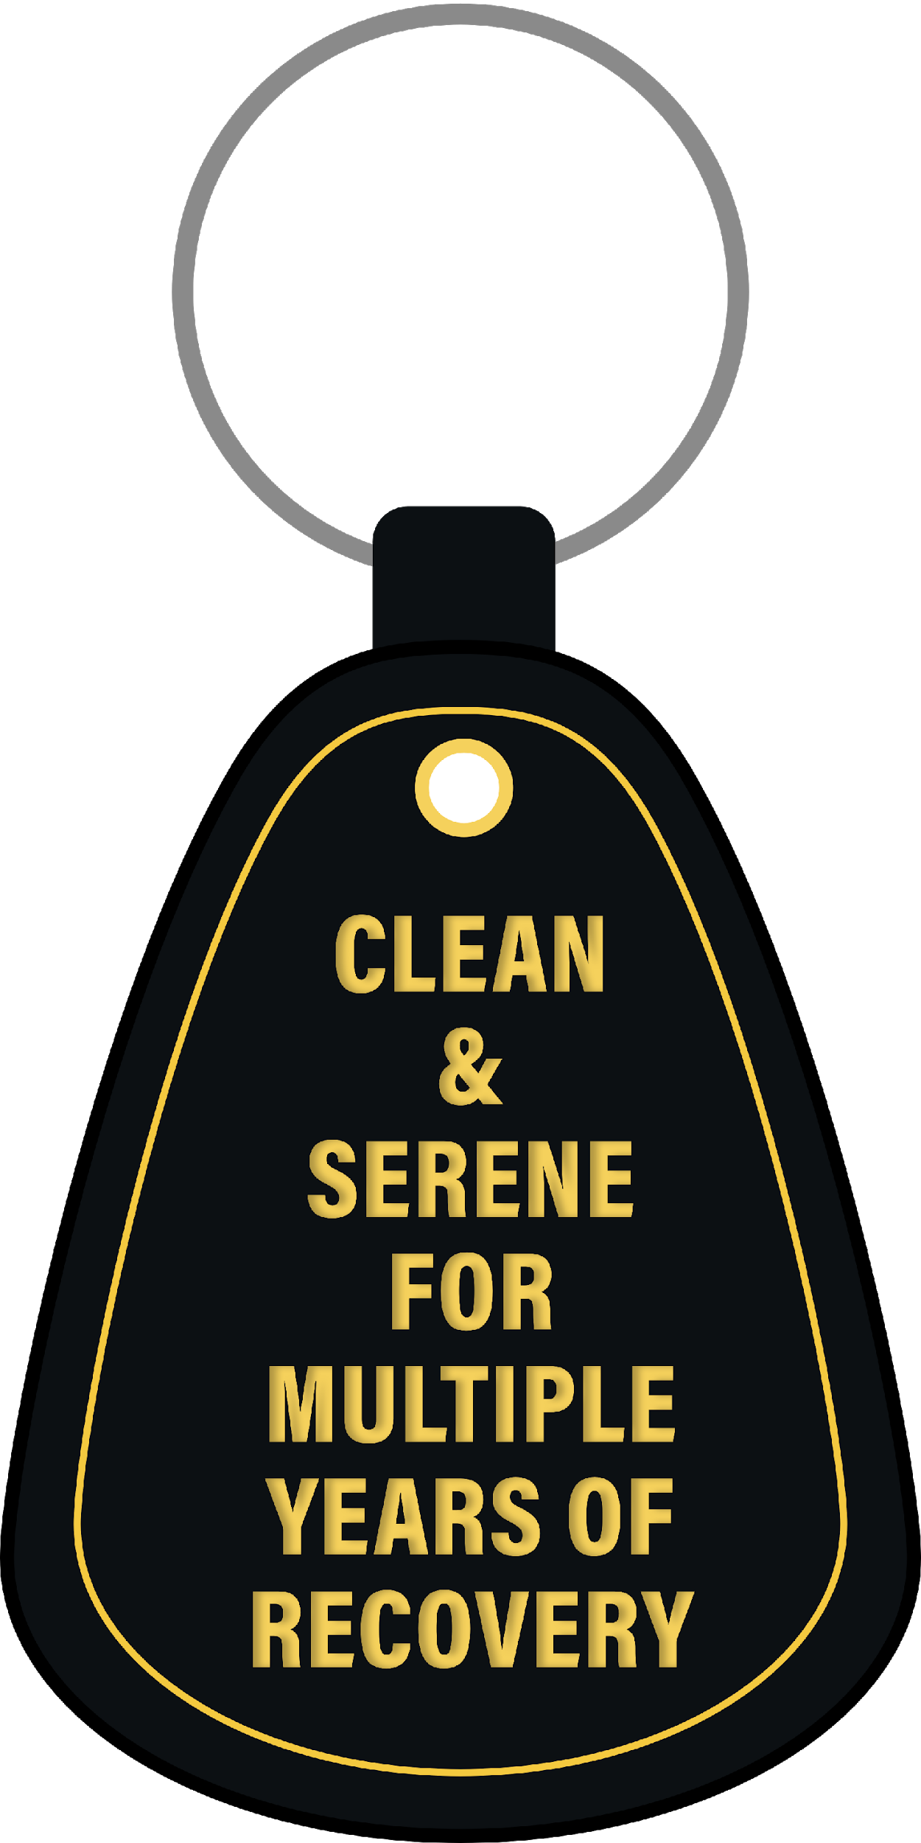
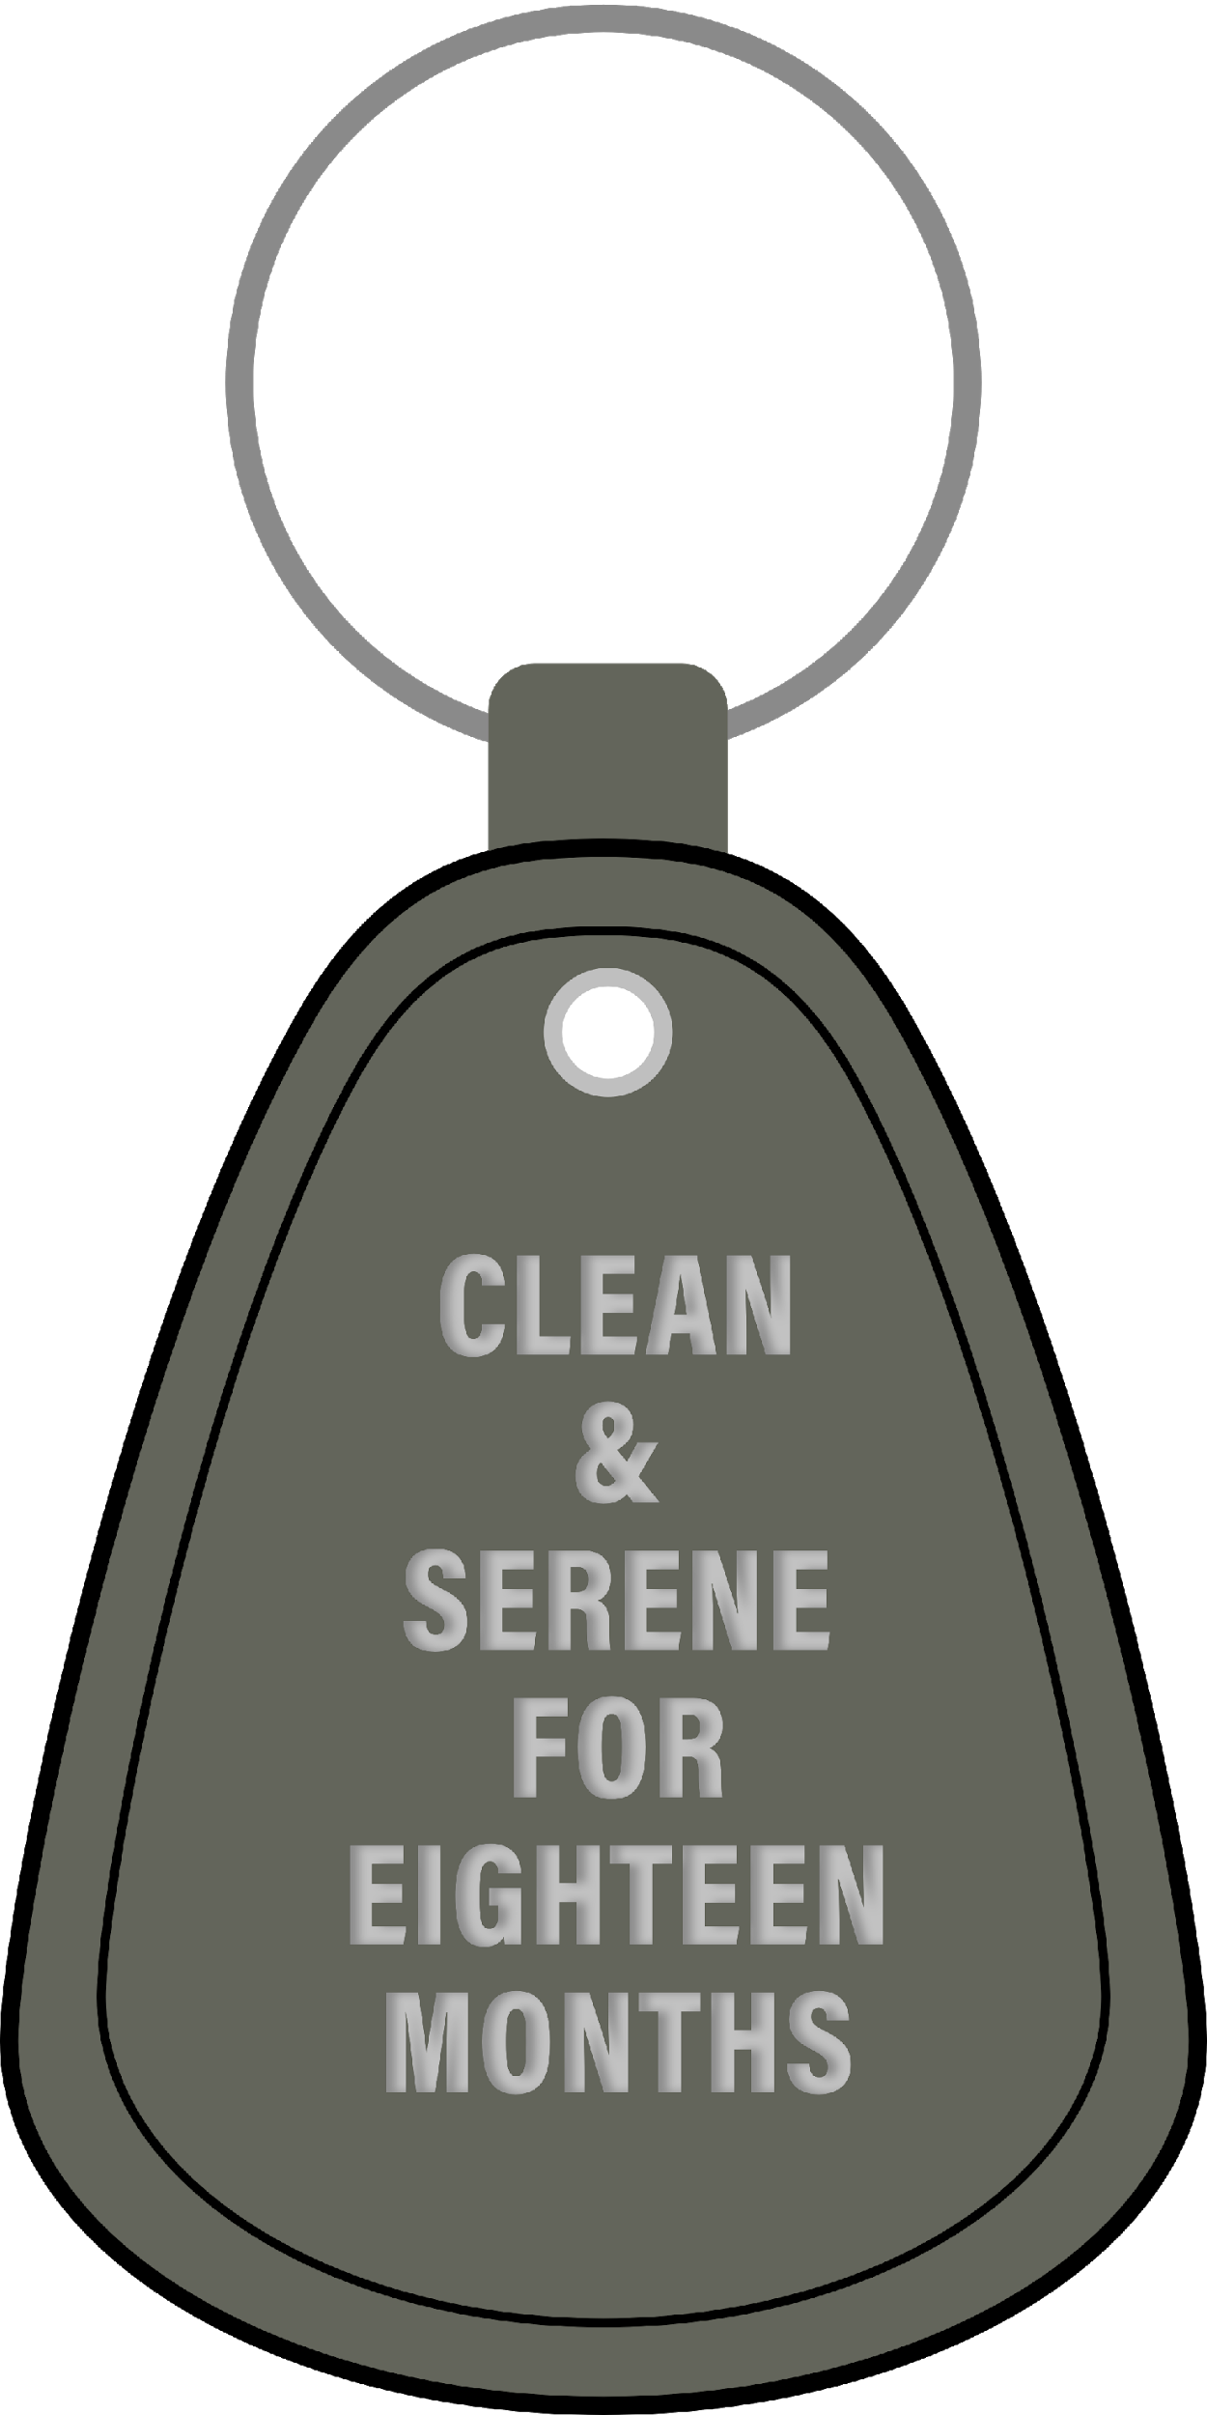
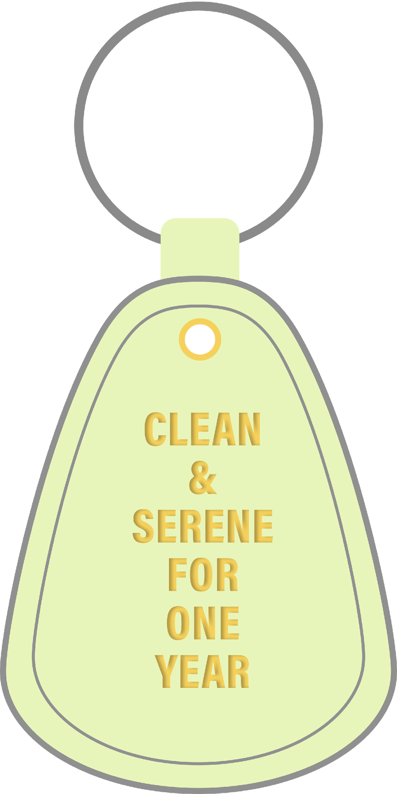
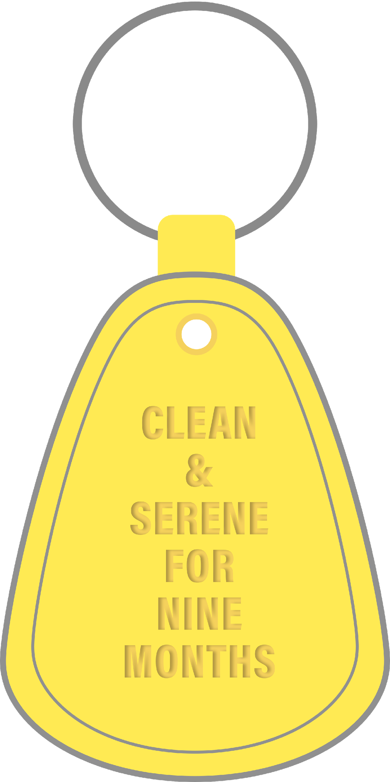
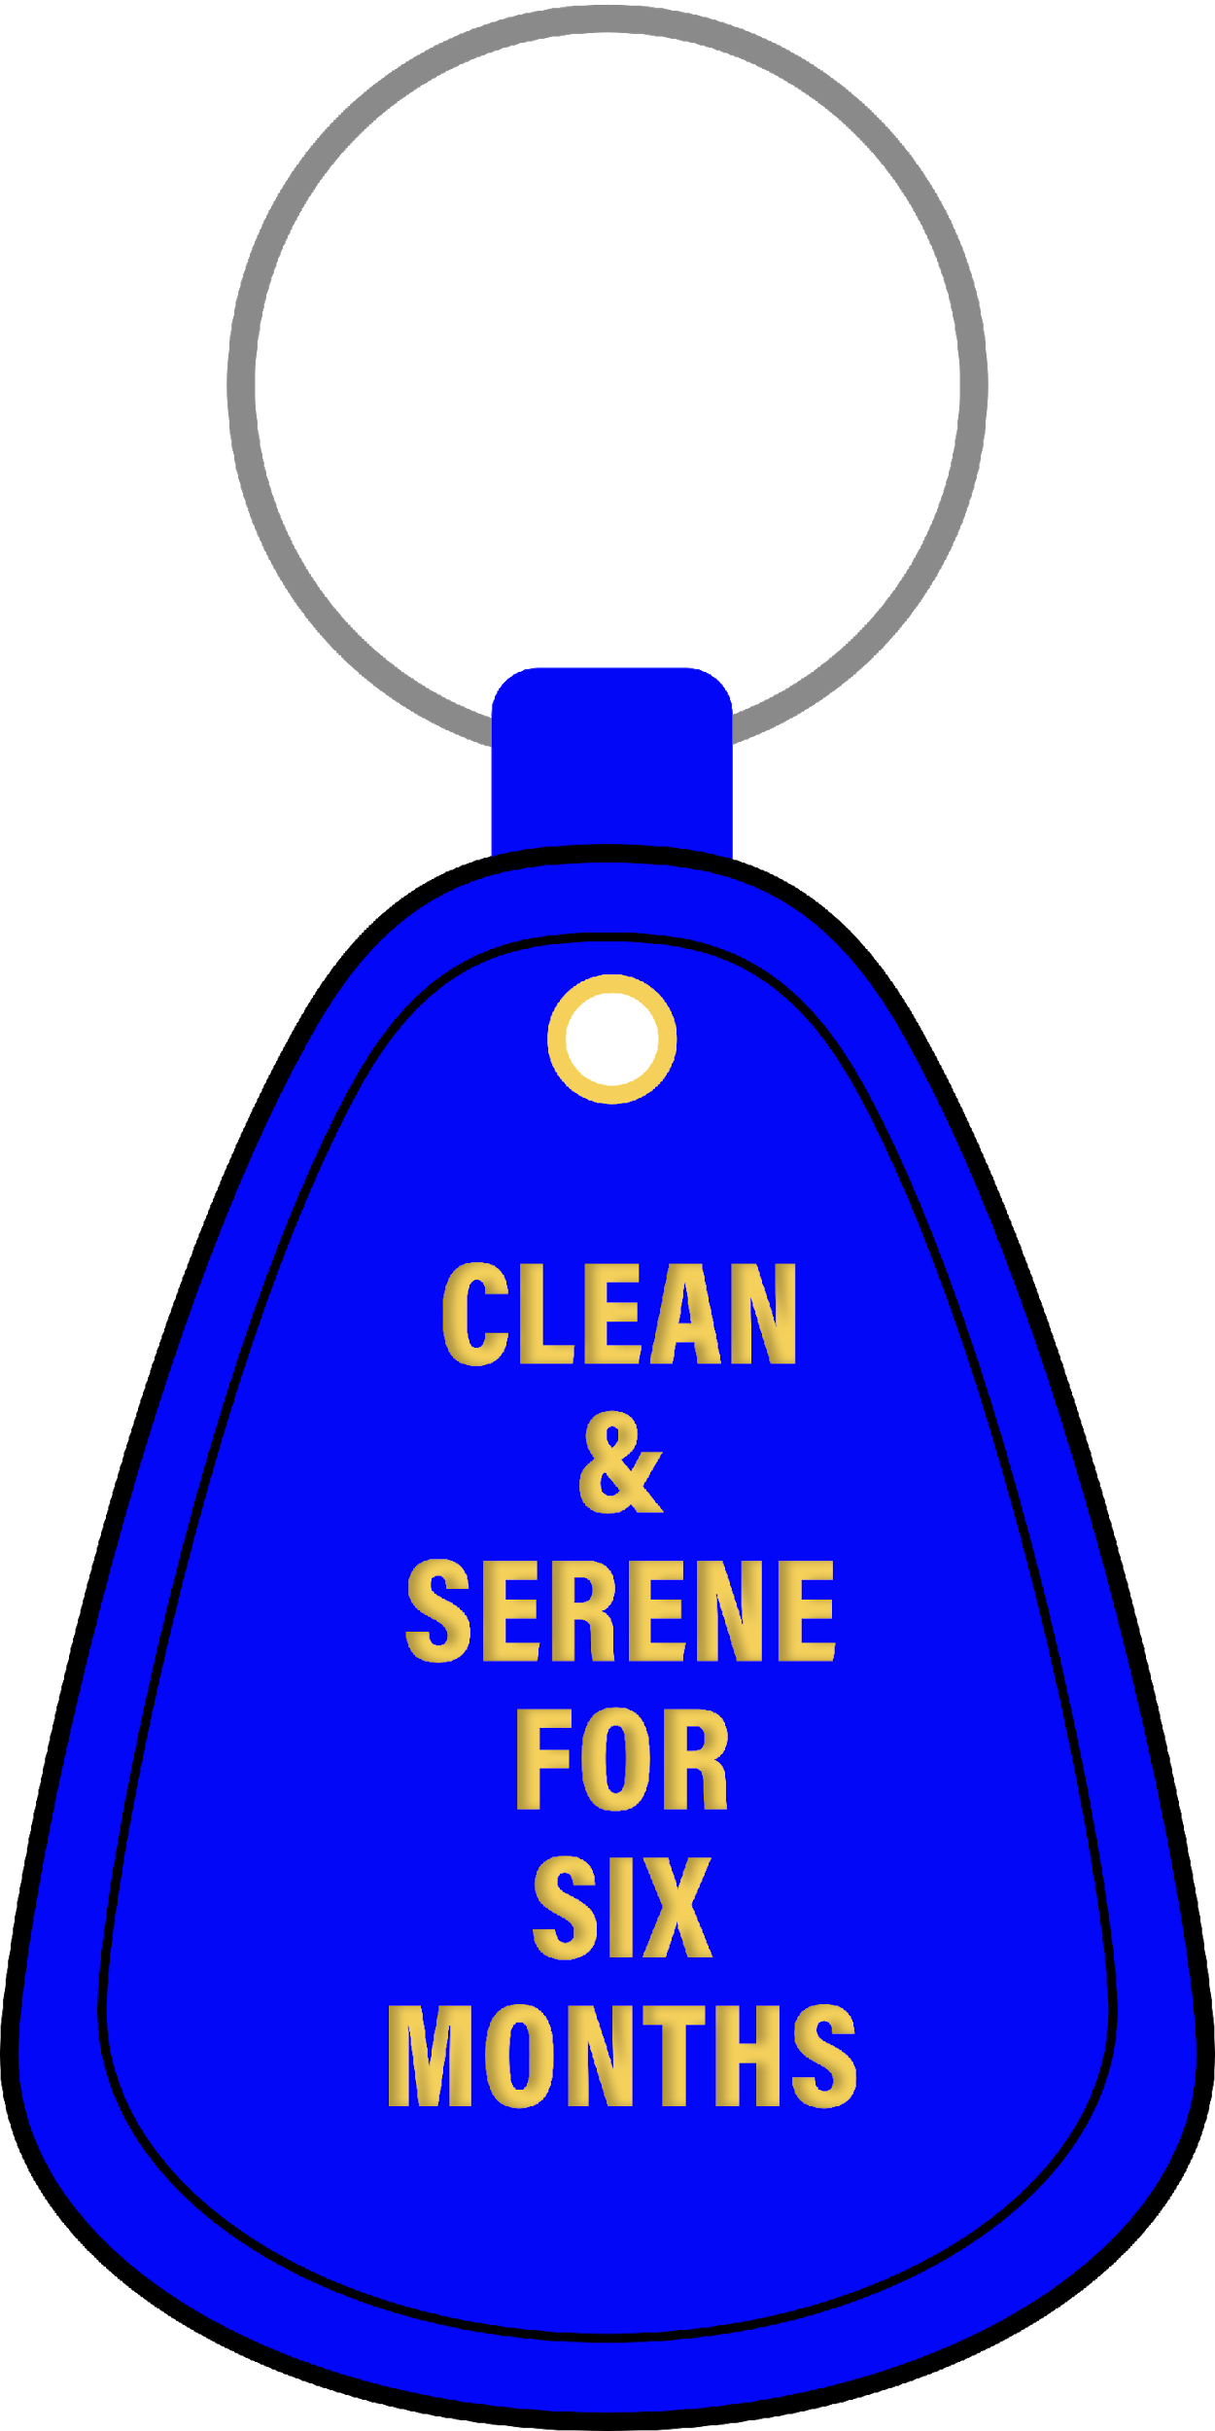
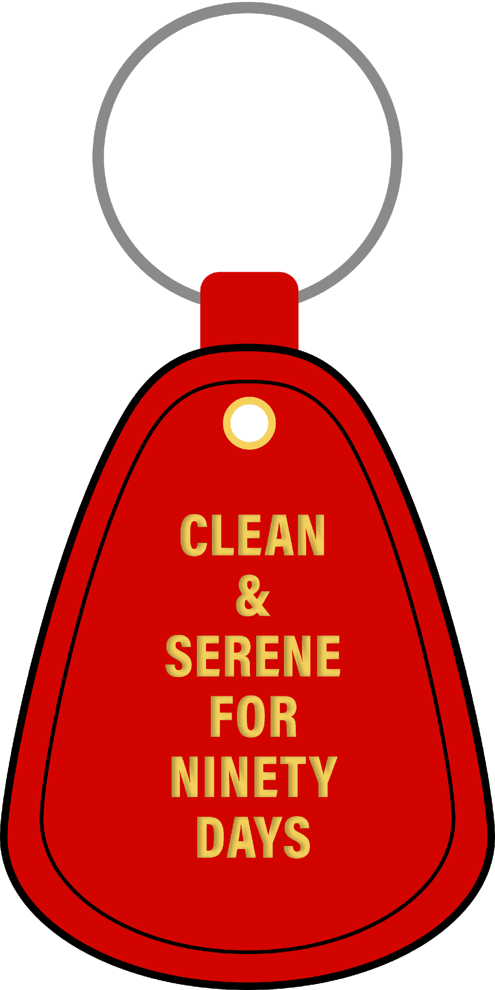
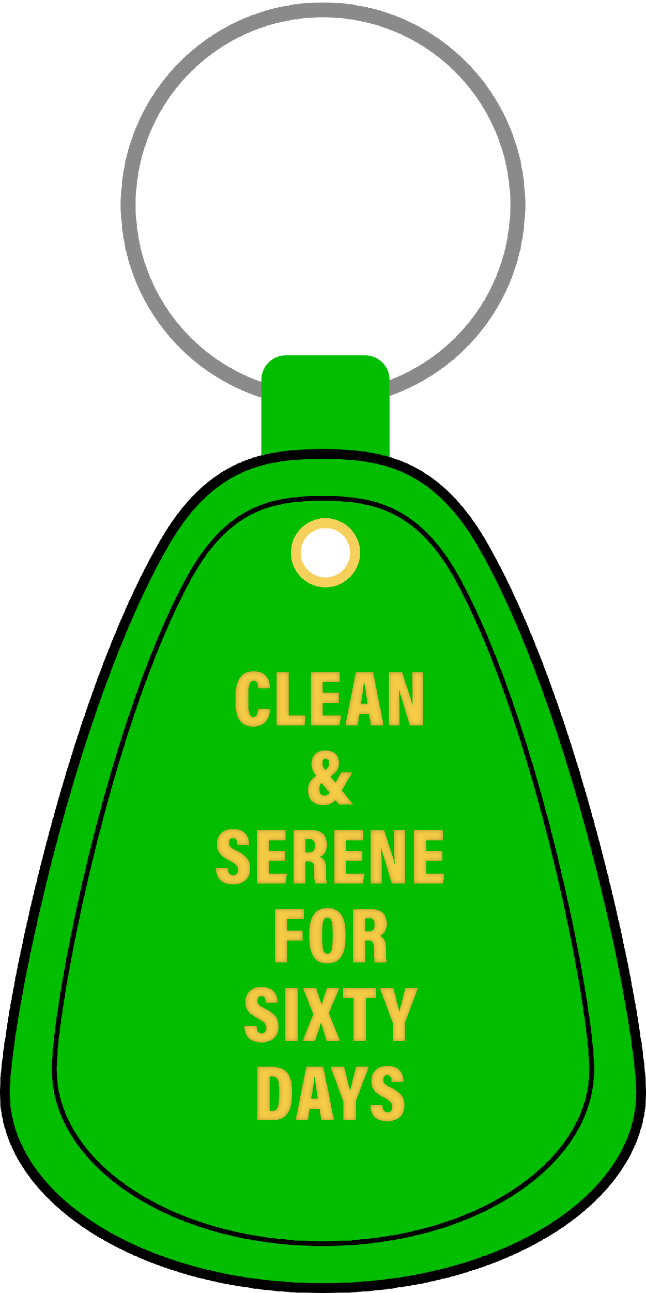
Key Tags
Who wants to hand out…

Slide 23
Any Newcomers?
24 hours
Coming Back
Here for First Time
Desire to Stop Using

Slide 24
Thirty Days

Slide 25
Sixty Days

Slide 26
Ninety Days

Slide 27
Six Months

Slide 28
Nine Months

Slide 29
One Year

Slide 30
Eighteen Months

Slide 31
Multiple Years

Slide 32
One more time for…
24 hours
Coming Back
Here for First Time
Desire to Stop Using

Slide 33
Give Your Higher Power a Round of Applause!

Slide 34
Just for Today
Tell yourself:
JUST FOR TODAY my thoughts will be on my recovery, living and enjoying life without the use of drugs.
JUST FOR TODAY I will have faith in someone in NA who believes in me and wants to help me in my recovery.
JUST FOR TODAY I will have a program. I will try to follow it to the best of my ability.
JUST FOR TODAY, through NA, I will try to get a better perspective on my life.
JUST FOR TODAY I will be unafraid. My thoughts will be on my new associations, people who are not using and who have found a new way of life. So long as I follow that way, I have nothing to fear.

